Slide 1
From Prediction to Shared Decision Making - A Patient Preference-Centered Treatment Recommendation
Tyler Gerding, Jake Hood, & Natalee Heriveaux

Slide 2
Clinical Prediction Alone is Not Enough
ML Limitations
Context
Problem statement
ML/AI models can estimate treatment effects very well, but can’t make the final call
Each patient is unique beyond just their outward characteristics
Physicians must balance both the physical realities/needs of a patient along with their emotional and preferential response to treatment options
Properly structuring patient needs can be a difficult task, often leading to patients preferences being disregarded or ignored

Slide 3
Dataset B
1,000 Future Patients
5 tokenized weights (WP1 to WP5) based upon a 100 point distribution system
Each weight corresponds to one outcome used in the CDS from the last challenge
Token totals do not always sum to 100 due potentially to rounding, survey interface
Preference weights are normalized to preserve relative importance for each outcome
Intentionally excludes the X,Y, and T variables from previous dataset, meaning this is explicitly based on a patient’s personal preferences
Note: next slide references provided scaling reasoning

Slide 4
Scaling Appropriately
Provided monetary anchors were used for w1,2, and 3; but this excludes two of the 5 output scales
The last two (w4 and w5) were standardized as penalty terms to maintain comparability
Rehab time (w4) was converted to a penalty of $1,000 per week of recovery - ends up being a very heavy penalty on average so this is adjusted to what’s typical in the data, then capped out at $25k
Out-of-pocket cost (w5) was multiplied by 1,000 then treated as a direct $ penalty, since it is already in dollars at this point it directly matches the other weights at this point

Slide 5
Methodology
Preference-Weighted Decision Framework
We convert treatment effects into a common value scale, weigh them based on preferences, and calculate a final score
1) Utilize the treatment effects from DataSet A
2) Translate these outcomes to a standard scale using the willingness-to-pay anchors provided (in this case $)
3) Normalize the patient preference weights from Dataset B
4) Gather values into a clear decision score (if score is above 0, recommend surgery)
5) Recommend treatment to assist in the clinical assessment and choice
wk​=WPk/∑WPj For j = 1 to 5, k being different outcomes
Wk - Patient Preference Weight, sum to 1ish
WPk - Token Score (1 to 5)
Vk = willingness to pay $ (ak) * direction(dk) * TEk (from Dataset A)
Vk - Value difference between surgery and conservative care, ak is the provided $ amount, dk +1 for better and -1 for worse
Dk- +1 if adds value, -1 if the outcome takes value
Score=∑wk​×Vk​ for k= 1 to 5

Slide 6
Mathematical Example for 117 (For reference)
WP1 = 32.84230393
WP2 = 11.27050540
WP3 = 59.58044664
WP4 = 18.51752513
WP5 = 25.09631866
w1 = 0.222951263
w2 = 0.076510266
w3 = 0.404464189
w4 = 0.125706943
w5 = 0.170367339
TE1 0.250474
TE2 -0.199238
TE3 0.250286
TE4 19980.826807
TE5 5.994707
From DataSet A
V1​=+25,000×0.250474=+$6,261.85​
V2​=−15,000×(−0.199238)=+$2,988.57​
V3​=+25,000×0.250286=+$6,257.15​
V4​=−TE~4​⋅25000≈−0.498979⋅25000=−$12474.48
(Normalized rehab effect)
V5​=−5.994707×1,000=−$5,994.71​
Normalized rehab: 1st percentile - avg TE4/99th percentile-avg TE4
Score117​=w1​V1​+w2​V2​+w3​V3​+w4​V4​+w5​V5​
Score117​≈1396.09+228.66+2530.79−1568.13−1021.30
Score117 = 1566.11>0, Surgery

Slide 7
Example
Patient 117 - John
Preferences: Higher weight on long-term function (w3 of 0.44) and long-term pain reduction (w1 = 0.23). Much lower concern on rehab time (w4 of 0.12) and cost (w5 of 0.17)
Trade-Offs (Derived from Dataset A): Surgery provides a +25% long-term pain reduction, +25% functional improvement, -20% short term pain reduction,$6,000 higher out-of-pocket cost, and a much longer rehab time
Recommendation: Surgery
Considering this patient’s weighted preferences and the clinical evidence provided from the previous model, we can reasonably suggest surgery as the best option for this patient
CEO

Slide 8
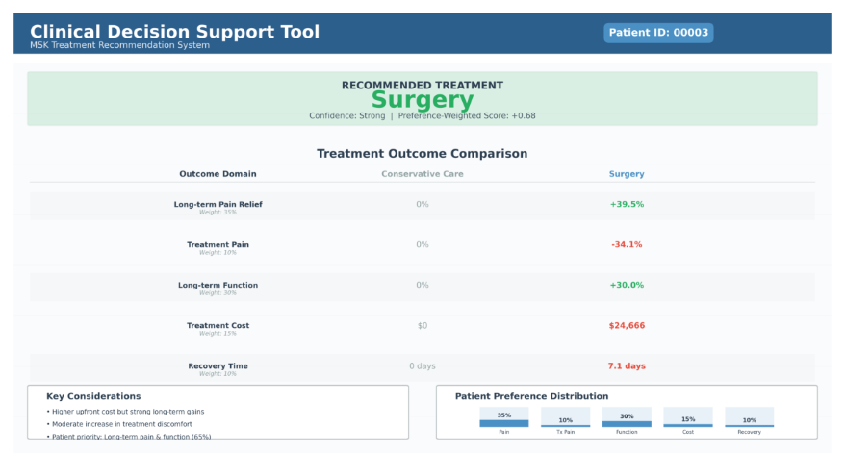
CDS Interface

Slide 9
How clinicians can use the CDS:
Patient completes a 100 - point preference survey before their evaluation
Clinician reviews the CDS and views the patient’s records
The CDS provides treatment recommendations based on historical clinical evidence as well as the patient’s preferences
Clinician reviews these outcomes with the patient, discussing benefits and trade-offs, then expressing their own expert insight
The healthcare professional can then further consult the patient with their personal values and priorities
The clinician and patient arrive at a shared decision on what treatment option will be best

Slide 10
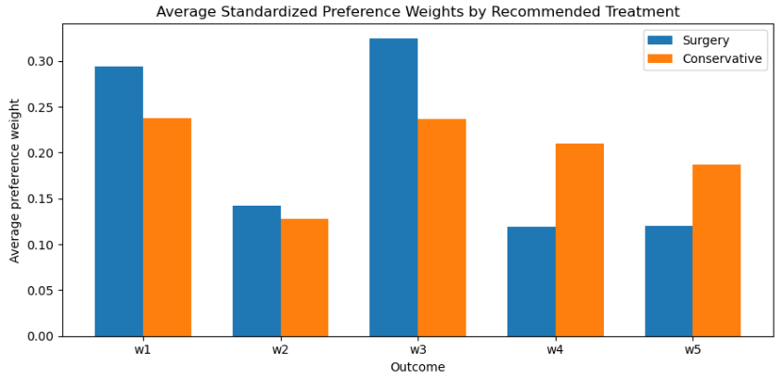
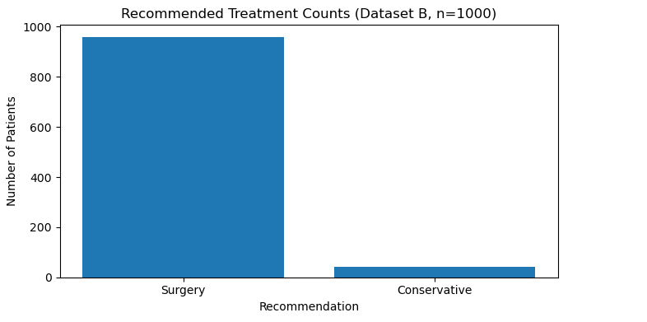
Results
Patients recommended surgery often place greater weight on
Long-term functional improvement (w3),. This is by far the most influential preference, patients wanting long term function are likely to be recommended surgery
Long-term pain reduction (w1 slightly)
Patients recommended conservative care place greater weight on:
Rehabilitation burden (w4)
Out-of-pocket cost (w5)
Treatment related pain (w2) matters, but this along with w1 are not the primary differentiators when considering long-term payoffs

Slide 11
Conclusions
Treatment decisions involve noteworthy trade offs across different patient preferences
Clinical evidence is great, but it isn’t everything when it comes to healthcare, especially considering patient values
The same clinical data in two patients may recommend an ideal situation to one patient, and a very inconvenient one to another
This CDS framework combines
Treatment effects based on clinical evidence
Patient provided preferences in their outcomes
The best decision is not just the most accurate, but is also the best fit for the clinician and the patient

